Slide 1

ODHE Updates October 2026 - OCTEO

Slide 2
Annual Data Reporting
Metrics Reporting System (MRS) is now open for the annual data reporting period.
All data should be submitted by November 30th @ 11:59 PM.
If user updates or program list updates are needed, please contact the MRS-Admin@highered.ohio.gov inbox.

Slide 3
PK-8 Program Transitions
Elementary and Middle Education (PK-8) Program Standards were published by ODHE in August 2025.
Educator Preparation Programs (EPP) PK-8 program review by ODHE will begin in January 2027 and continue in each following review cycle.
Development of the new Ohio Assessment for Educators Assessment of professional Knowledge and PK-8 content assessment by Evaluation systems of Pearson is in development.
EPPs begin accepting incoming first-year students into a PK-8 program no later than Fall Semester 2028.
SBOE retires the PK-5 and 4-9 licenses December 31, 2032. This is 5 years after the last student entered a PK-5 or 4-9 program in Fall Semester 2027.

Slide 4
Updated Social Studies Standards
The Ohio Department of Education and Workforce has released updated
K-8 Social Studies Standards.
Updated standards are available on the ODEW website.
Educator Preparation Programs should begin aligning to these new standards for Elementary and Middle Education (PK-8) programs for review no later than January 2028.
Institutions can choose to use the new standards prior to January 2028. The updated crosswalk is available on the ODHE website.

Slide 5
K12 Mathematics Plan + OMI Alignment : Autumn 2026 Meeting Takeaways
Create a more cohesive math "system"/infrastructure within Ohio.
Increase access to high-quality instructional resources for math.
Increase educator preparation and support for facilitating math instruction, balancing the needs to understand math content, math instructional practice, and math intervention/remediation.
Strengthen math pathways through increased accessibility and advising.
Familial and community engagement and support.
Update or modernize math assessments.

Slide 6

Grow Your Own Teacher Scholarship Awards
 | 2024–2025 Cycle | 2025–2026 Cycle | 2026–2027 Cycle
Nominated | 229 | 856 | Waitlist Awardees
Completed Applications | 200 | 639 | N/A
Awarded | 168 | 206 | 201
Accepted | 164 | 168 | 134
Notes:
466 individuals have accepted awards so far.

Slide 7
Teach Computer Science 2.0 Grant
14 sites are offering programs through the grant program. These programs include professional development sessions, graduate credit, and endorsement programs.
Data collection for 2024 through June 2026 is currently underway.
Bowling Green State University
Cleveland State University
East Central Ohio ESC
ESC of Central Ohio
ESC of Western Reserve
Kent State University
Malone University
Miami University
Montgomery County ESC
North Point ESC
Shawnee State University
University of Akron
University of Toledo
University of Cincinnati

Slide 8
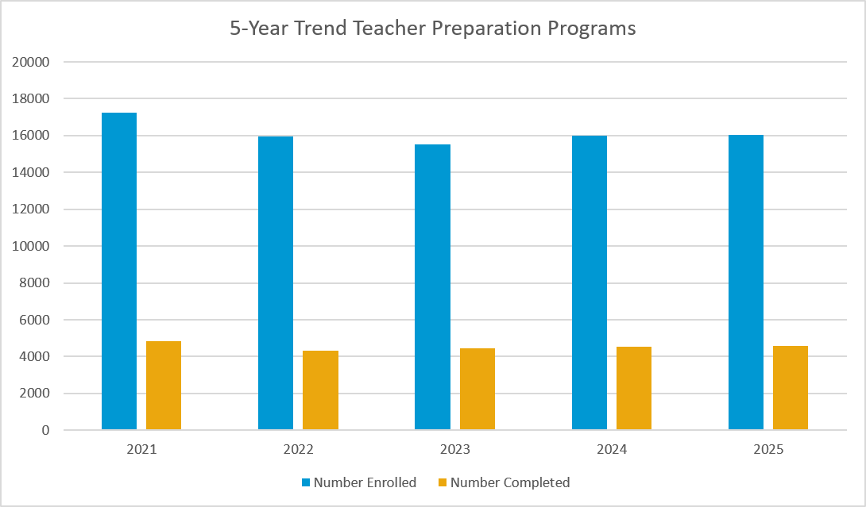
Educator Preparation Programs State Data
During the 2024 – 2025 academic year a total of 4592 candidates completed teacher preparation programs across Ohio.
Notes:
2021; 17241; 4824
2022; 15934; 4337
2023; 15530; 4433
2024; 16005; 4517
2025; 16044; 4592

Slide 9
Educator Preparation Programs State Data
During the 2024 – 2025 academic year a total of 4592 candidates completed teacher preparation programs across Ohio.
Notes:
2016 18905 5105
2017 18086 4853
2018 17206 4802
2019 17177 4942
2020 17819 4811
2021 17241 4824
2022 15934 4337
2023 15530 4433
2024 16005 4517
2025 16044 4592

Slide 10
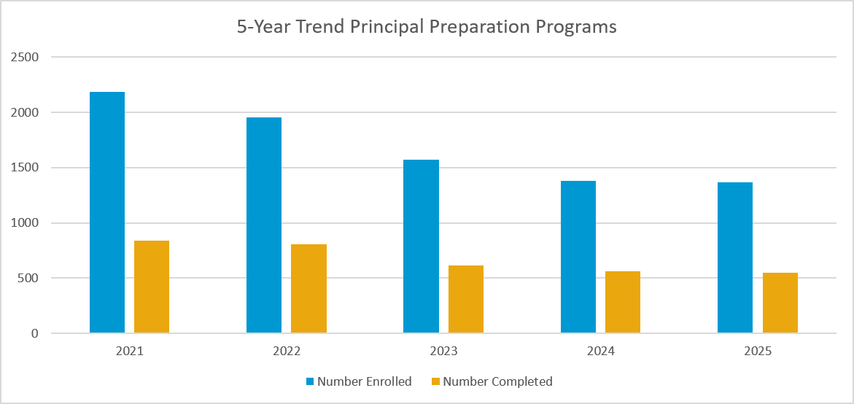
Educator Preparation Programs State Data
During the 2024 – 2025 academic year a total of 550 candidates completed principal preparation programs across Ohio.
Notes:
2021; 2187; 842
2022; 1957; 807
2023; 1572; 616
2024; 1380; 561
2025; 1370; 550

Slide 11
ODHE Summer Intern - Update
Over the summer months ODHE hosted an undergraduate intern who completed a project using ODHE Educator Preparation data.
The project reviewed completer data and compared the location of where students completed their educator preparation program and then where they obtained their first teaching position.
The undergraduate intern used report year 2024 data for the project.

Slide 12
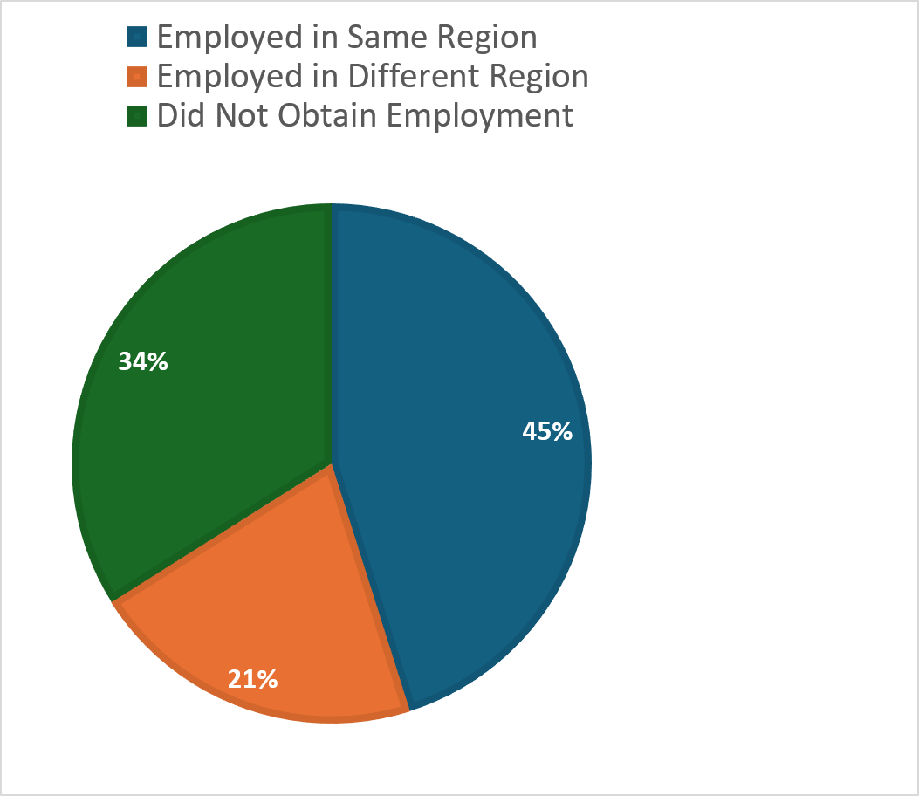
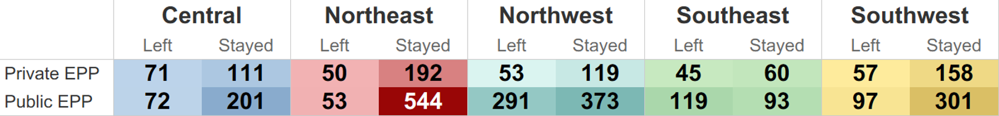
ODHE Summer Intern - Update
Over the summer months ODHE hosted an undergraduate intern who completed a project using ODHE Educator Preparation data.
This data reflects those candidates who obtained a teaching position in a district that reports to the Ohio Department of Education and Workforce.
Candidates who obtained employment in non-public school settings are not included in this report and are reflected in the "Did Not Obtain Employment" section in the pie chart.

Slide 13
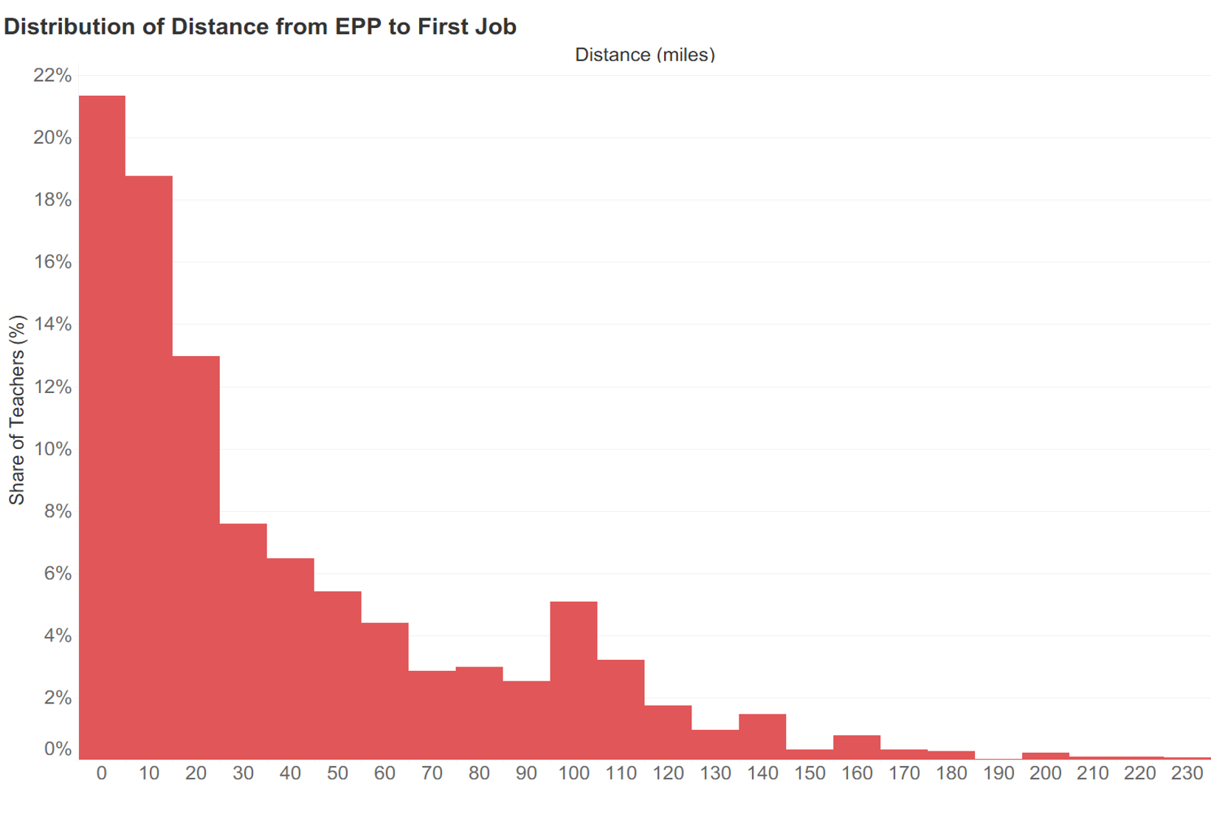
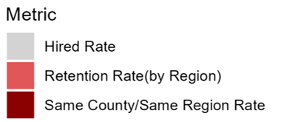
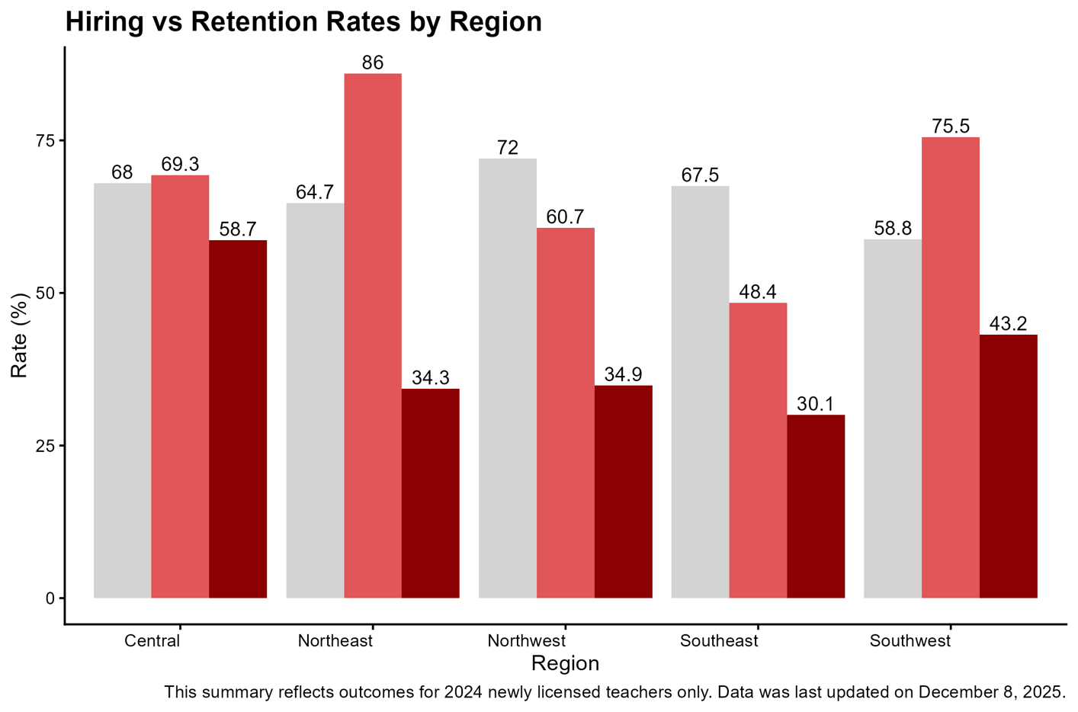
ODHE Summer Intern - Update
Over the summer months ODHE hosted an undergraduate intern who completed a project using ODHE Educator Preparation data.
Notes:
Graph on the left indicates the number of miles candidates find employment within. This indicates that over 40% of completers secure employment within 20 miles of their EPP.
Chart on the right indicates the percentage of candidates who were reported as obtaining their initial license. Of that percentage the light red bar indicates how many completers stayed with the same region as their EPP and the dark red bar indicates how many completers stayed in the same county as their EPP.

Slide 14
ODHE Summer Intern - Update
Over the summer months ODHE hosted an undergraduate intern who completed a project using ODHE Educator Preparation data.
The undergraduate intern determined that over 40% of completers are hired within 20 miles of their EPP.
Northeast graduates are most likely to stay local, while Southeast graduates are significantly less likely to remain in the region.

Slide 15
Ed Prep Updates
You can now sign up to receive EdPrep communications, such as newsletters or special announcements using this link.
Sign up is also available on the EdPrep Updates webpage.

Slide 16
Ed Prep Contacts
EdPrep@highered.ohio.gov
MRS-Admin@highered.ohio.gov
SOR@highered.ohio.gov
GYO@highered.ohio.gov
TeachCSGrants@highered.ohio.gov

